Slide 1
WATER IMPURITY ALERT SYSTEM
FINAL REVIEW
BATCH NO. 07 GUIDE- Mr. V RAJ KUMAR,
Assistant Professor, EECE.
A.K.SRAVANTH-121710408003
K.YOGEESWAR-121710408023
M.SHALINI-121710408028
S.BHARATH-121710408041

Slide 2

Business Problem:
One of the main reasons why people get health problem is impure water in overhead water tank. Impure overhead tank will be problematic because pathogens can live in turbid water. Fecal contaminations of water can introduce a variety of pathogens into waterways, including bacteria, viruses, protozoa and parasitic worms.
Impurities

Slide 3
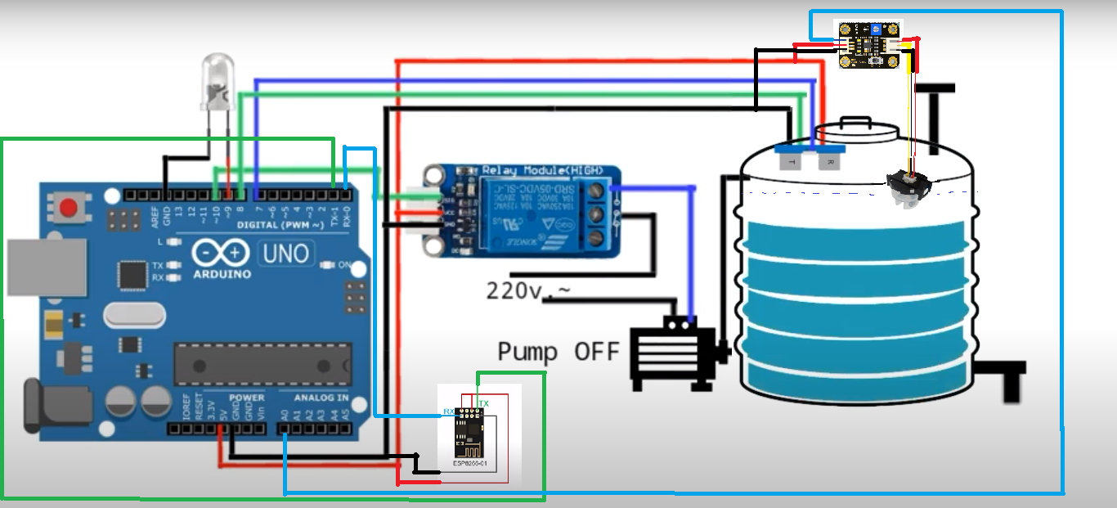
Proposed Solution:
This problem can be solved by sending an alert to the user whenever the water in overhead tank turns dirty. This is achieved using turbidity sensor which detects the impurity level in water.

Slide 4
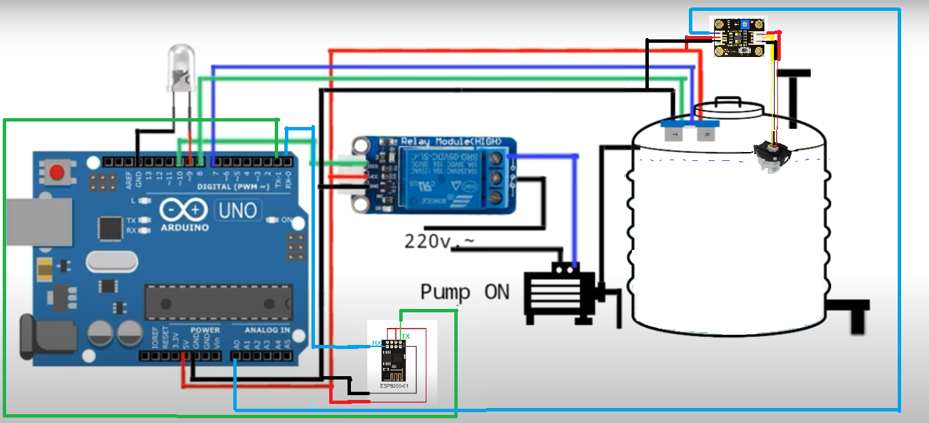
In order to stop the water level to detectable range of turbidity sensor, ultrasonic sensor is used to control the level of water in tank.

Slide 5
COMPONENTS USED
1.Arduino Uno
2.Esp8266 Wi-Fi Module
3.Turbidity Sensor
4.Ultrasonic Sensor

Slide 6
SENSORS USED
Turbidity Sensor
Operating Voltage: 5V
Sensitivity:0.0008
Analog Range:0 to 1024 (Higher the value lesser the water turbid)
Working:
This sensor uses infrared LED for the light source and uses infrared phototransistor to detect how much the amount of light not blocked by the turbid water.
The mode of action of this sensor is based on the principle that when light is passed from photodiode to phototransistor in water, the amount of light transmitted through water depends on the amount of other matter suspended in the water .
If the amount of other material increases then the amount of light transmitted by the photodiode towards the phototransistor will be reduced because it is blocked by other materials .

Slide 7
Turbidity of Water (NTU) = (1.873+ (0.518 × Total Suspended Solids (mg/l)))
Output Voltage (V)= 0.0008× (Turbidity of Water (NTU)) + 3.9994
where,
0.008 is the sensitivity of the sensor
3.994 is the output voltage when the sensor detects 0 NTU
Ref-Sendra S, Parra L, Lloret J and Jiménez J M 2015 Oceanographic multisensor buoy based on low cost sensors for Posidonia meadows monitoring in Mediterranean Sea Journal of Sensors

Slide 8
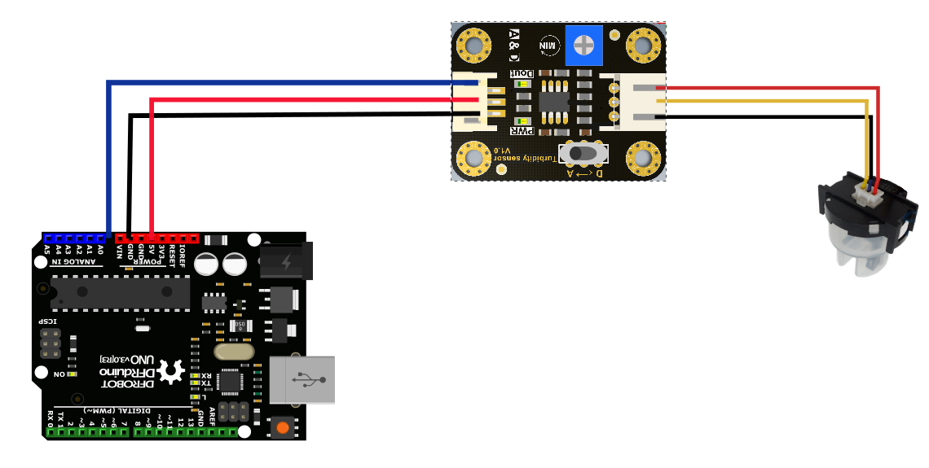
CIRCUIT DIAGRAM:

Slide 9
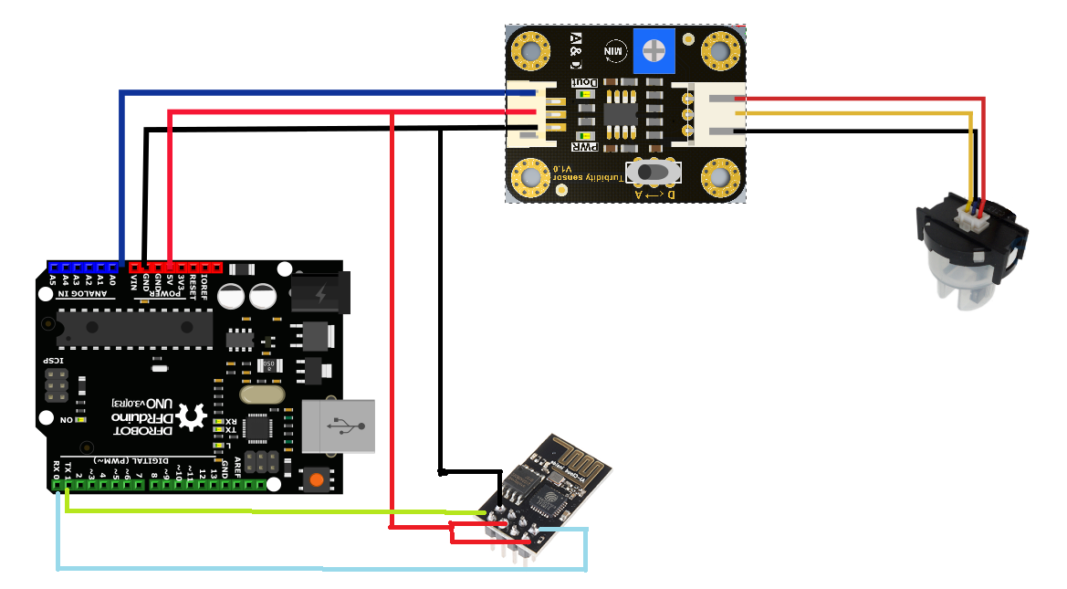
INTERFACING WITH WIFI MODULE

Slide 10
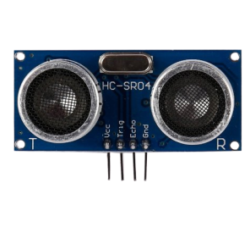
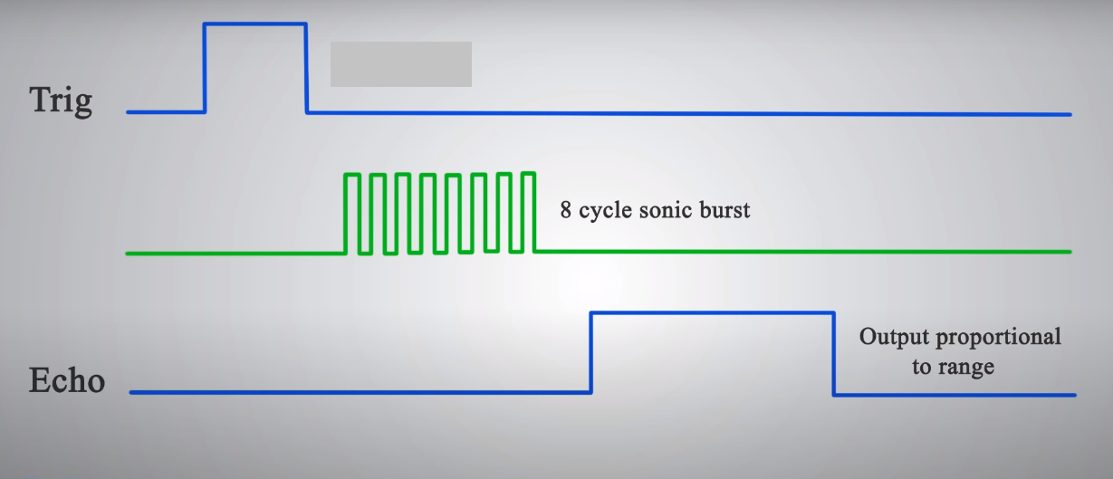
Ultra sonic sensor:
Ultrasonic ranging module HC - SR04 provides 2cm - 400cm non-contact measurement function, the ranging accuracy can reach to 3mm. The modules includes ultrasonic transmitters, receiver and control circuit
Ranging accuracy-3mm
Emits ultrasonic waves at 40,000Hz

Slide 11
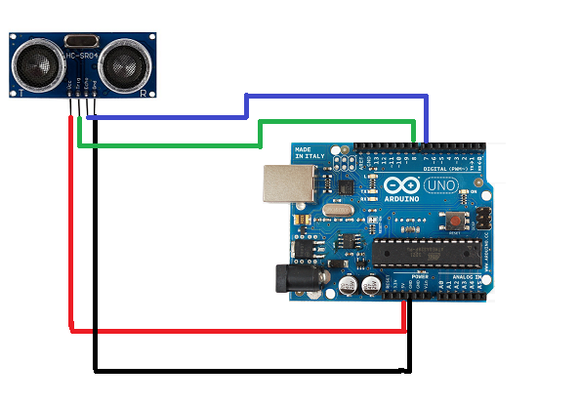
CIRCUIT DIAGRAM:

Slide 12
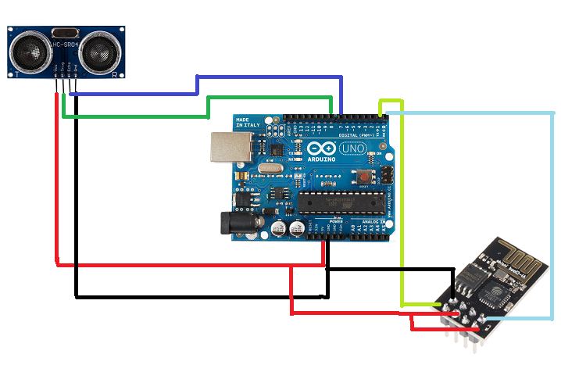
INTERFACING WITH WIFI MODULE

Slide 13
CIRCUIT DIAGRAM

Slide 14

CODE

Slide 15


Slide 16
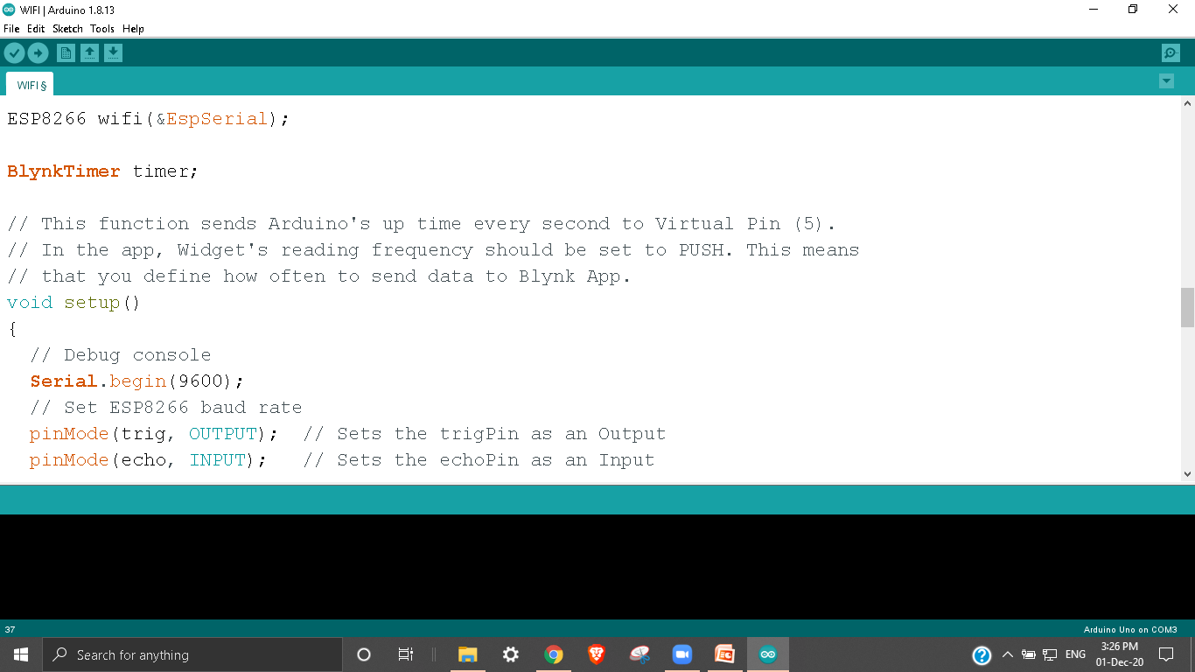

Slide 17
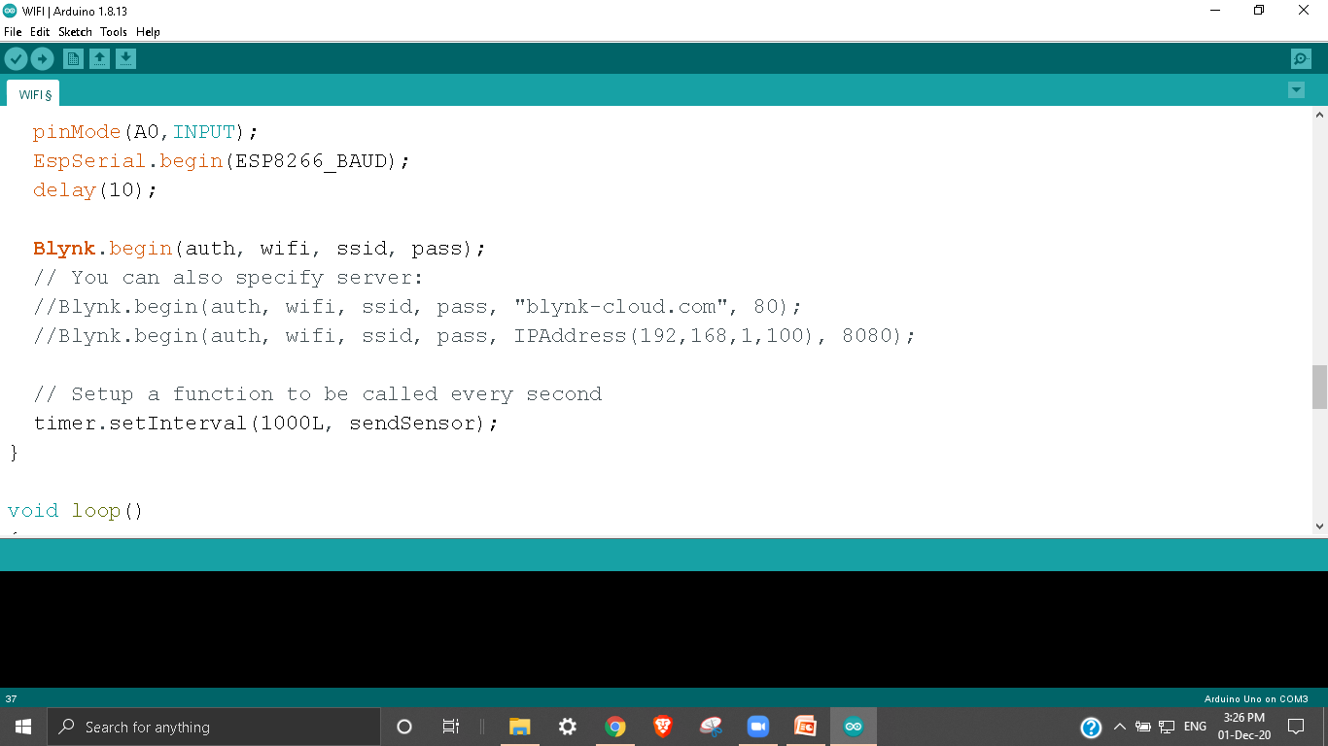

Slide 18
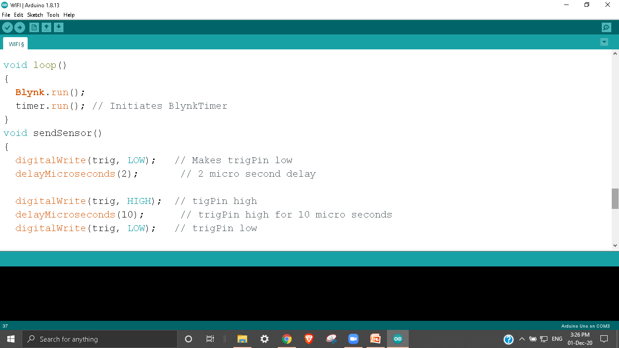

Slide 19
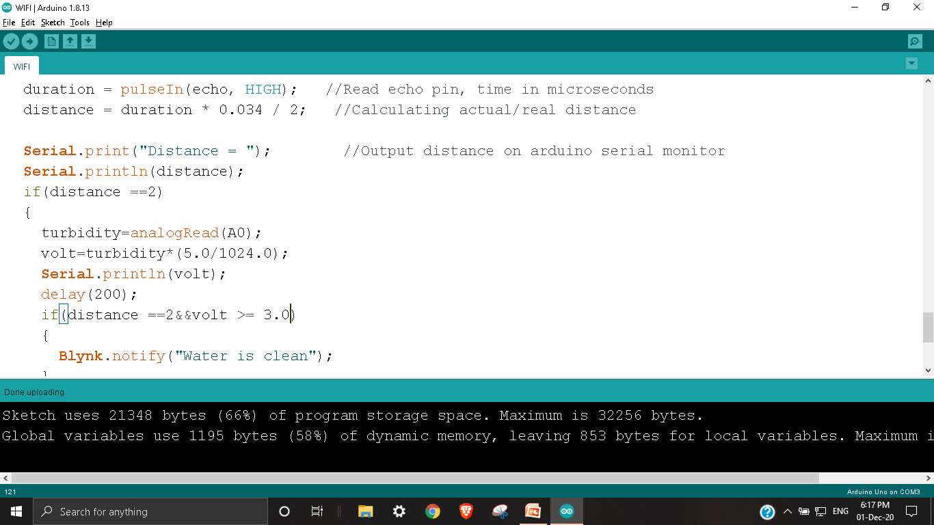

Slide 20
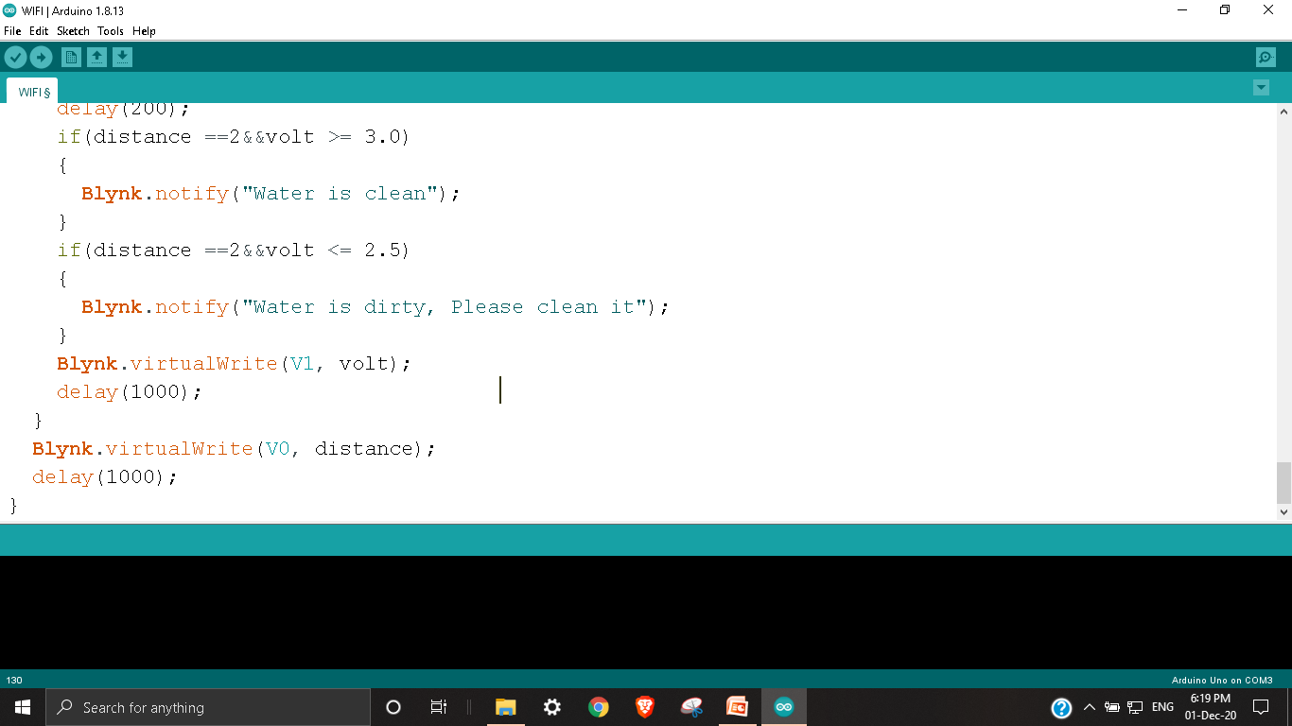

Slide 21


Slide 22

Conclusion:
In this way many health problems caused due to germs and impurities present in overhead tank can be reduced.

Slide 23
Proposed tech stack : Turbidity sensor is used to detect the level of impurities present in water and using Ultrasonic sensor water level in tank can be controlled. Using arduino and wifi module the impurity level is monitored and an alert is sent to the user whenever water turns impure.
Market place : This solution will reduce many health problems caused by impurities present in overhead tank.
Theme Alignment : Internet of things.

Slide 24
THANK YOU

